Slide 1
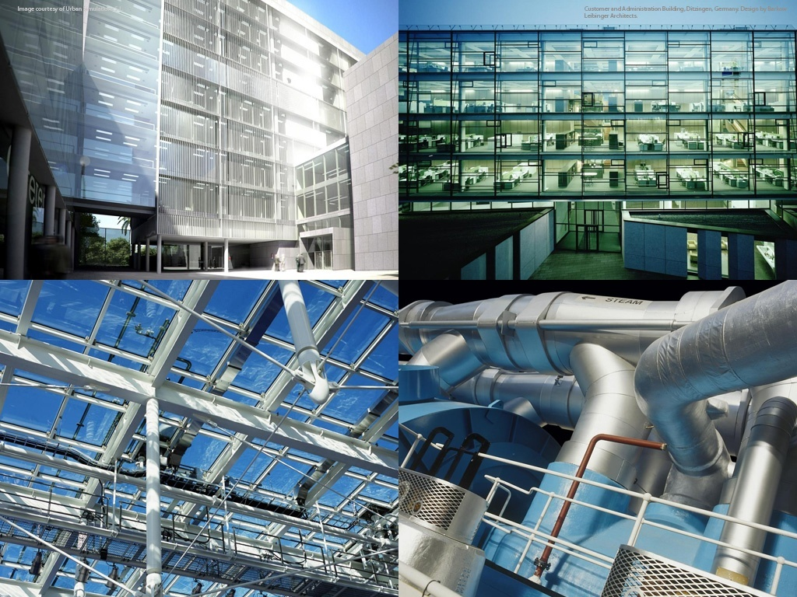
Autodesk Revit ® 2011 Family API Hands on Training
Trainer’s name
Developer Consultant
Developer Technical Services
Notes:
AEC Title

Slide 2
Family API Labs Exercises
Incremental exercises to create a column family:
Lab1 – create a column family with rectangular profile
Lab2 – create a column family with L-shaped profile
Lab3 – add formula and assign materials
Lab4 – add visibility control

Slide 3
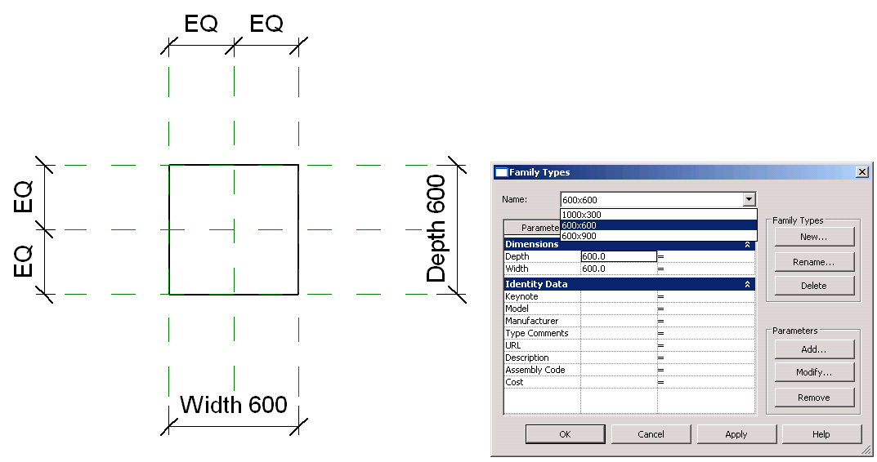
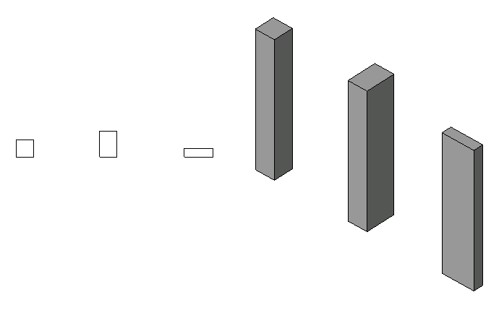
Lab1 – Create a Rectangular Column
Objective: learn THE basics of family API.
check the family context
create a simple solid using extrusion
set alignments
add types
Classes and methods:
rvtDoc.IsFamilyDocument()
rvtDoc.OwnerFamily.FamilyCategory.Name
rvtDoc.FamilyCreate.NewExtrusion()
rvtDoc.FamilyCreate.NewAlignment()
familyMgr = rvtDoc.FamilyManager
familyMgr.NewType()
familyMgr.Parameter(); familyMgr.Set()

Slide 4
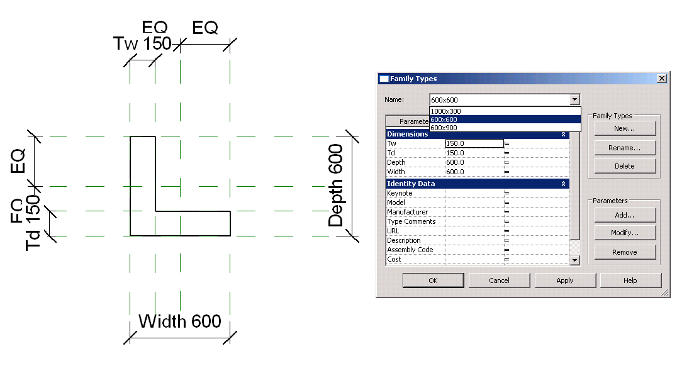
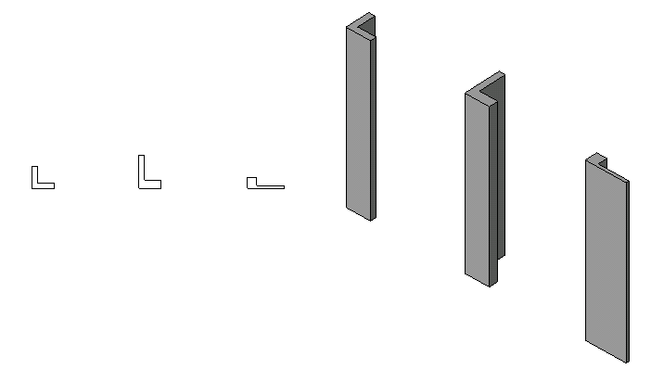
Lab2 – Create a L-Shape Column
Objective: learn the basics of family API.
add reference planes
add parameters
add dimentiones
Classes and methods:
rvtDoc.FamilyCreate.NewReferencePlane()
familyMgr.AddParameter()
rvtDoc.FamilyCreate.NewDimension()

Slide 5
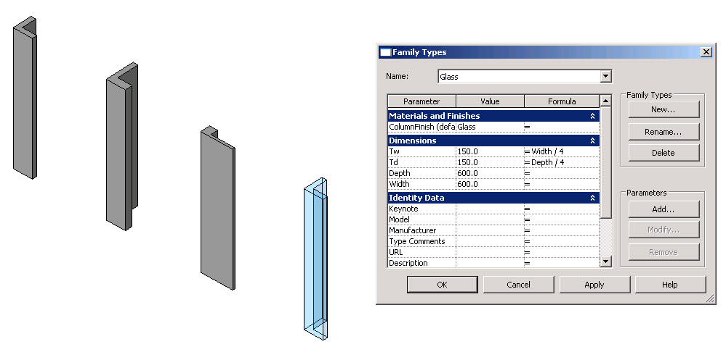
Lab3 – Add Formulas and Materials
Objective: learn the basics of family API.
add formulas
add materials
Classes and methods:
familyMgr.SetFormula()
pSolid.Parameter(“Material”)
familyMgr.AddParameter(“MyColumnFinish”, BuiltInParameterGroup.PG_MATERIALS, ParameterType.Material, True)
familyMgr.AssociateElementParameterToFamilyParameter()

Slide 6
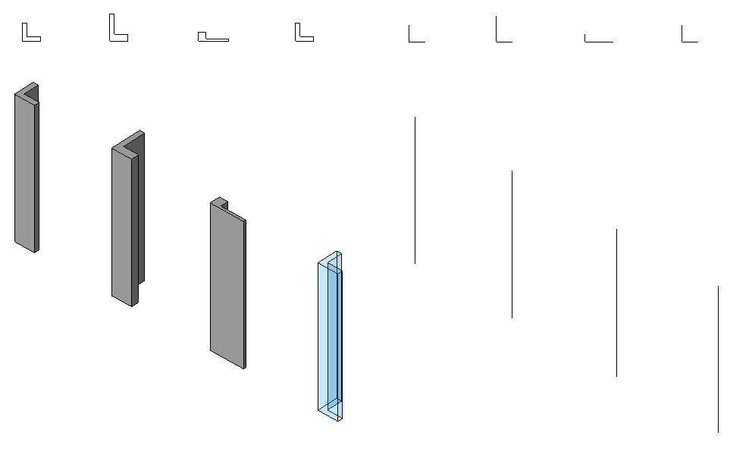
Lab4 – Add Visibility Control
Objective:
add line representation
add visibility control
Classes and methods:
rvtDoc.FamilyCreate.NewSymbolicCurve()
rvtDoc.FamilyCreate.NewModelCurve()
FamilyElementVisibility(FamilyElementVisibilityType.ViewSpecific/Model)
FamilyElementVisibility.IsShownInFine, etc.
pLine.SetVisibility(pFamilyElementVisibility)

Slide 7
